Slide 1
Chantilly High School Athletic
Training
Program
Notes:
1
You can edit the colors by:
clicking on the first slide
click on edit and select “select all”
Click on Design and on the right side a list of options will appear.
Choose an option that is available or click on color schemes
if you chose color schemes design your own colors.
Edit the Content to meet your Schools names and personel.

Slide 2
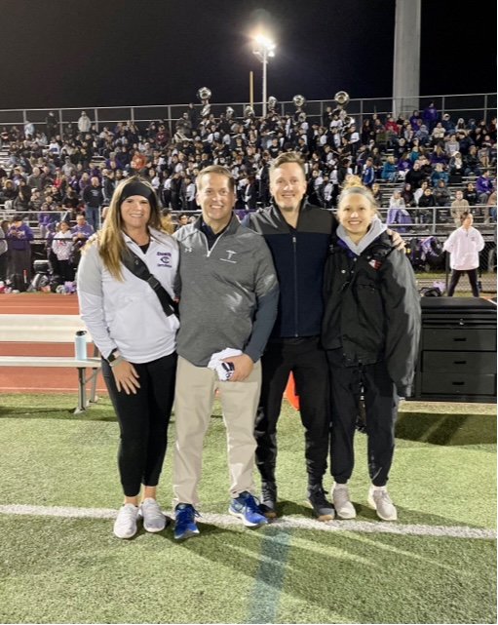
Chantilly Athletic Training Staff
Head Athletic Trainer:
Katelyn Bishop, MS, VATL, ATC
Kabishop@fcps.edu
Associate Athletic Trainer:
Rachel Scherbenske, MS, VATL, ATC
Team Physician
Dr. Robert Patton
Fairfax Family Practice
Team Ortho
Dr. Dave Novak
OrthoVA
Athletic Training Clinic: 703-222-8170
Athletic Trainer Mobile: 571-363-7825
Clinic Hours:
Mon - Fri 2:55pm-6:30/7pm (and all home events)
insert picture

Slide 3
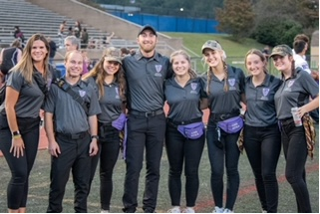
Others You May See
The following may also be working with us throughout the season. These students assist us as they learn more about the athletic training profession. Although they work with us, any questions or concerns should be directed towards one of the Licensed Athletic Trainers.
Graduate Students
- None this winter
Athletic Training Student Aides
AT1 & AT2 happily welcome any high school students that wish to help in the athletic training room and learn more about the athletic training profession. Varsity Letters may be awarded to students at the discretion of the Athletic Training Staff and the Director of Student Activities.
Notes:
*OPTIONAL SLIDE

Slide 4
Assumption Of Risk
Not all injuries can be prevented
Catastrophic injuries can occur in any sport
FCPS’s comprehensive Athletic Training Program statistics have proven to influence a reduction in the severity of injury.
Notes:
4
Proper diet contains 60-70% CHO, 15% PRO, 15% Fat
Replace 22 – 24 oz of H2O for every pound loss.
NO FCPS employee can supply, endorse or encourage the use of nutritional supplements.
One of the best recovery foods following intense exercise is chocolate milk.

Slide 5
Responsibilities of the Athletic Trainer
PREVENTION of injuries/re-injury
RECOGNITION, EVALUATION and ASSESSMENT of injuries and conditions
IMMEDIATE CARE of injuries
REHABILITATION and reconditioning of injuries
Organization and administration
Professional development and responsibility

Slide 6
Athletic Training Coverage Policy
Athletic Training Clinic
The AT will be available for evaluations, treatments, rehabilitation, and questions after school each day.
ATs are on-site until the start of the last practice or end of competition.
Outside of those hours, questions/concerns can be addressed via email or phone.

Slide 7
Athletic Training Coverage Policy
Athletic Contests
Most contests are covered by the home athletic trainer, exceptions include:
Fall
An AT is at all Football Practices and Games.
XC will be covered by an assigned AT
Golf does not have an AT on site, but AT is available by phone
Winter
Indoor Track is covered by an assigned AT
Regular season Swim & Dive does not have on site coverage, but the post-season does
Spring
All spring sports are covered by the home AT, although we often have multiple activities running simultaneously, so you may or may not see us at your event, but we’re on campus.

Slide 8
Injury Reporting
All injuries & illnesses must be reported to the Athletic Trainers prior to return to activity regardless of severity or physician consultation
Our philosophy is to return injured athletes to participation in the quickest and SAFEST manner possible using a progressive return to activity

Slide 9
Care of Injuries
Injuries can be treated in different ways depending on the severity. Methods may also be combined to best suit the athlete.
MEAT
Movement - pain-free
Exercise
Analgesics - If cleared by parent/guardian
Treatment - various modalities
RICE
Rest
Ice –
“Cold”/Freezer vs “Warm”/Ice Machine- yes, it really is a thing!
Compression
Elevation – Above the Heart
When in doubt- RICE is always a safe bet
See your AT to help pick the one that’s right for your issue!
Think you need a brace?
Notes:
9
Add information regarding limited participation and progression of return to full participation

Slide 10
Care of Injuries
We encourage you to see the AT before heading to the doctor
Athletic injuries are our specialty- we can care for many of them on site- saving you time, the hassle of making an appointment, and money!
We work with our team physician and often communicate questions/issues we can solve on site
We do refer to physicians when we feel necessary and can glady guide you to the proper specialist if needed. In this case, we’ll often provide a form to be completed so we can work cooperatively with the physician.
If you see a physician on your own, please report any findings and share the documentation they may have provided.
Notes:
10
Give example of injury that occurs when AT is not on site

Slide 11
Rehabilitation Programs
Rehabilitation and reconditioning is a primary role of the Certified Athletic Trainers
From sprains and strains to post-surgical, we have the tools and time to work with your athlete.
Every injury requires some form of rehabilitation

Slide 12
Return To Play
A Parent, Coach, Family Physician, Athlete, Administrator, AT, or Team Physician can exclude an athlete from participation.
Depending on the injury, it is possible the athlete will be guided through a limited participation phase before a full return to play.
The role of the Athletic Trainer is to make sure your athlete is safe to return to play.
We cannot shorten the length of rest stated on a doctor’s note.
We may extend the return date on a note if we feel that the athlete can not return to play SAFELY after a sport-specific evaluation.

Slide 13
Nutrition
Make NUTRITION a priority!
Nutritional balance and meal timing are important.
Proper hydration is essential!
There are no quick fixes! Real food is far better for the body than any pill or supplement.
Supplements often aren’t worth the risks.

Slide 15
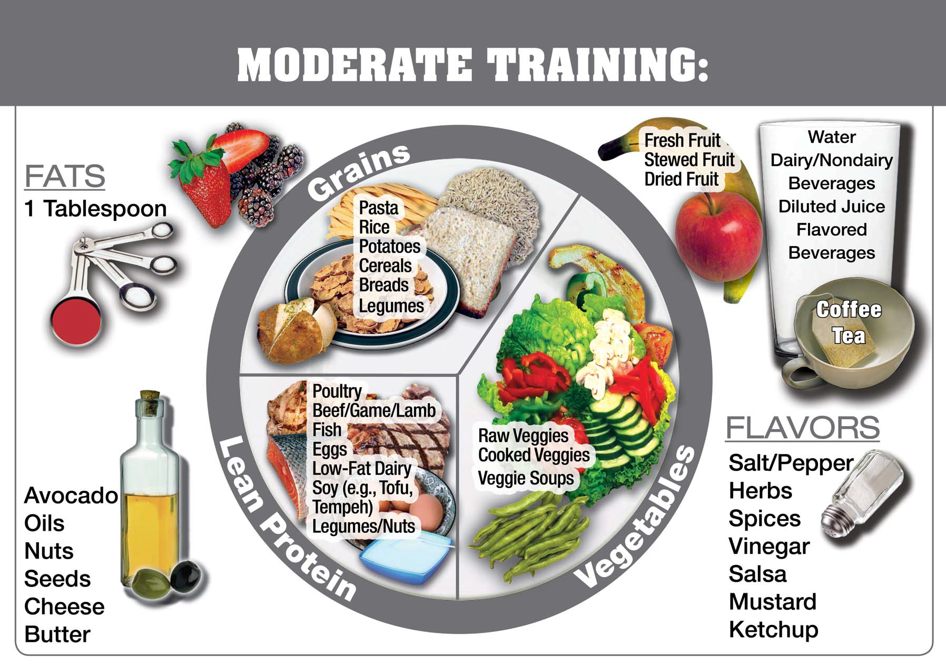

Slide 17
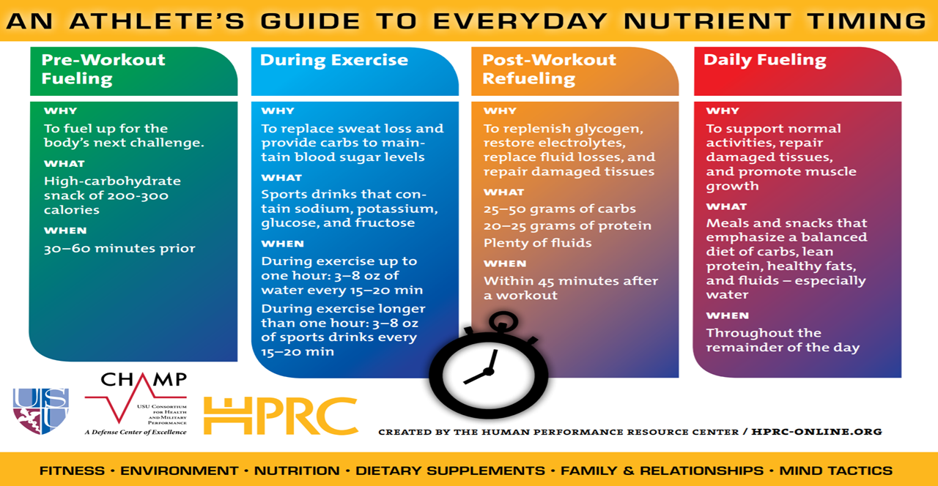
Meal Timing

Slide 18
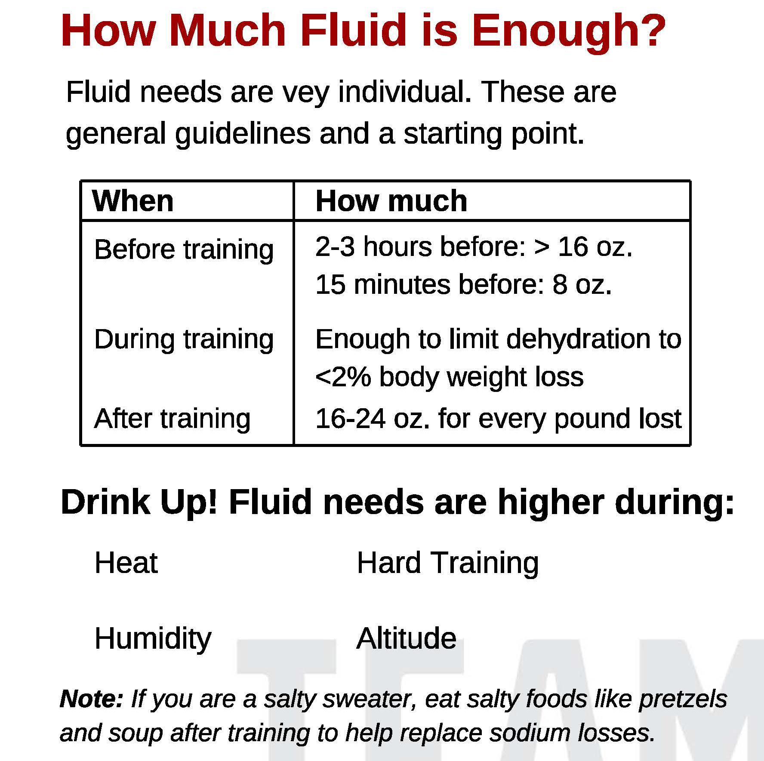
Hydration
Proper hydration improves performance by:
Enhancing the body’s ability to regulate temperature & cool efficiently while avoiding unnecessary elevation in heart rate
Improving ability to recover quickly from training & competition
Minimizing muscle cramps
Enhancing mental function, decision making, concentration & motor control
Supporting effective immune defenses

Slide 19
Dehydration
Signs & Symptoms of Dehydration:
Lack of concentration
Early fatigue in training session
Trouble tolerating heat
Delayed recovery
Muscle cramps
Headaches
Nausea & vomiting
Heart rate elevated above normal response

Slide 20
Supplements
Dietary supplements can have a purpose…
Educating yourself before making decisions is important.
Supplements are not regulated by the FDA, and may contain substances not listed on the label.
Speak with an informed medical professional
For more information, visit www.USADA.org
***Be Aware***
Supplements claiming fat-burning/weight loss, performance gains, and pre-workout mixtures are more likely to be contaminated with anabolic steroids, stimulants, and other banned substances.

Slide 21
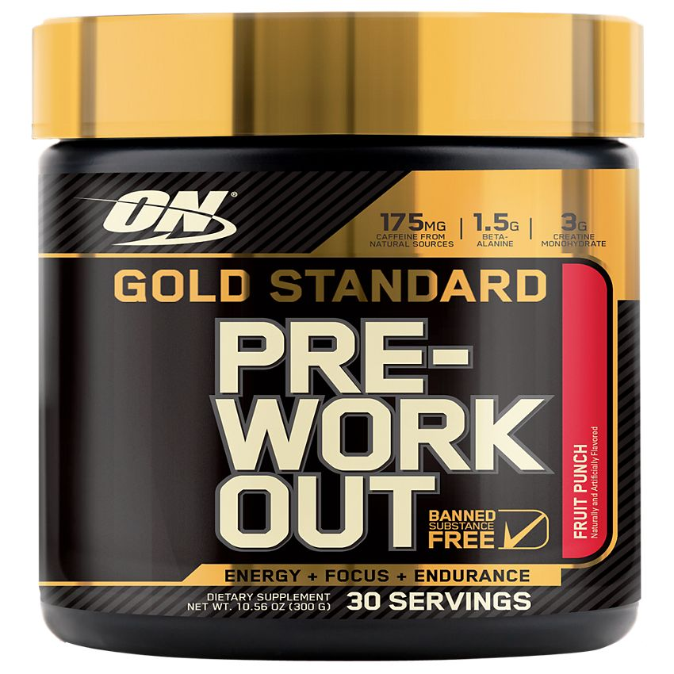
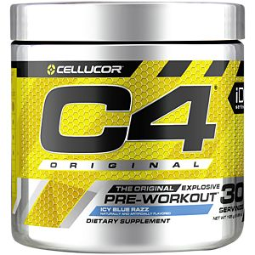
Pre-Workout &
Energy Supplements
The National Federation of High School Sports STRONGLY DISCOURAGES the use of ENERGY products
Inherent Risks
Unnecessarily high amounts of caffeine & other ingredients cause the heart rate to reach dangerous levels
Any existing medical conditions could increase the dangers of taking a pre-workout supplement
Athletes with high blood pressure, heart conditions or rhythm irregularities, or diabetes should refrain from using pre-workout
Positive drug testing due to unreported ingredients
Side Effects
Increased HR, insomnia, diarrhea, dehydration, headaches, nausea, anxiety, high BP, jitteriness/restlessness
For more information, visit: https://www.nfhs.org

Slide 22
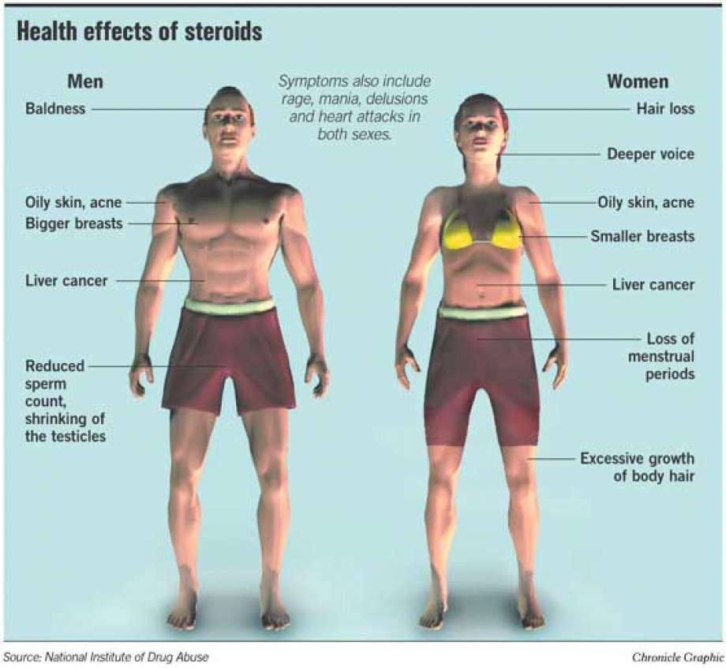
Steroids
Other Signs & Symptoms of steroid use:
rapid mood swings
rapid strength gains
bad breath
drastic appetite shifts
stretch marks
jaundice
The consequences for being caught using steroids is a
2-year disqualification
from sports.
This is a VA state law, so it also applies to Universities

Slide 23
Universal Hygiene
Clean clothes and equipment daily
Shower after all practices/competitions
Assure proper use of water bottles and cleaning them daily
Encouraging these practices are essential to minimizing the risk of communicable diseases including
MRSA and COVID-19

Slide 24
Communicable Illnesses
Prevention is Key!
Athletes should:
Shower immediately after practice
Wash Hands often
Not share water bottles, clothing or personal hygiene items
Hydrate and get plenty of rest
If your athlete has a rapid onset of: fever, sore throat, chest congestion, and or body aches; they should
stay home and see their family physician.

Slide 25
Concussion Education Review
May be caused by a direct blow to the head, face, neck or elsewhere on the body
Concussion is not usually associated with structural damage to the brain; Routine imaging (CT scans, MRIs, x-rays) likely normal
Typically features rapid onset of symptoms that may evolve over minutes, hours or days
Concussion may or may not involve a loss of consciousness (LOC)
Concussion results in a wide range of symptoms lasting a few minutes, days, weeks, months or longer in some cases

Slide 26
Neurocognitive Assessments
Computer-based neurocognitive assessment:
Is used to examine memory and processing speed
Is one of several tools used by athletic trainers to evaluate students with a concussion
Does not diagnose or provide clearance for a concussion by itself
Post-injury neurocognitive assessments are administered as needed during student recovery
Neurocognitive assessments require students to focus their attention, read instructions and complete various subtests with practice opportunities prior to each task.

Slide 27
Concussion Education Review
Trauma
Signs/Symptoms or “Feeling Different”
Remove from activity, Rest, and Report
Suspect a concussion if a student:
BEHAVES DIFFERENTLY following trauma to the head or body
EXPERIENCES SYMPTOMS (headache, light sensitivity, nausea, irritability, depression/anxiety, etc.)
HAS TROUBLE CONCENTRATING OR SLEEPING (sleeping too much or not enough)
Remove from activity and report the injury to the athletic trainer or another adult
WHEN IN DOUBT, SIT IT OUT

Slide 28
Support your Chantilly Athletic Training Program!
Physical Night is June 1st, 2022
$50

Slide 29
Conclusion
Please contact me at kabishop@fcps.edu if you have any questions!
Thank you!

